Slide 1
BizPlus AI
A successful HTTP response can hide
a missing customer order
Business transaction monitoring and approved recovery
The demo checks the outcome, captures evidence,
and verifies the original order after a worker resume.
BizPlus AI 1/7
Notes:
Introduce the problem with the owned shop demo. A confirmation response returns HTTP 200 while the original order is missing. All payments and customers are synthetic. No external production failure or measured business loss is claimed.

Slide 2
Customer impact of missing confirmation
What the system shows | What the customer experiences
Checkout succeeded | No confirmed order to rely on
Confirmation returned HTTP 200 | The order field is empty
Payment recorded once | Uncertainty may encourage a retry
Recovery must preserve the original payment
A business assertion checks the order and amount, alongside status codes.
BizPlus AI 2/7
Notes:
Describe consequences qualitatively. A paid customer without confirmation may contact support or retry checkout. The prototype does not measure revenue saved, support cost, or production incidence. These are business risks illustrated by synthetic data.

Slide 3
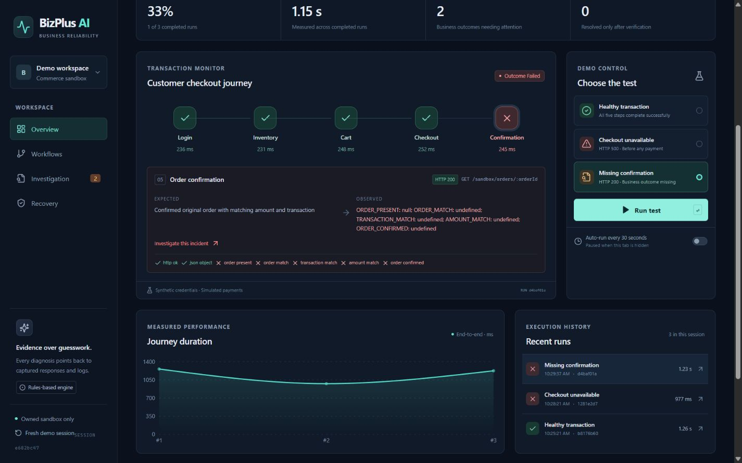
Monitoring with visible evidence
Run a scenario and inspect its actual HTTP results
Rules-based diagnosis Synthetic payments Isolated demo sessions
BizPlus AI 3/7
Notes:
The screenshot is the actual locally verified BizPlus AI dashboard. Its cards and charts derive from stored run results. Show run progression, expected and actual assertions, and the separate count of verified recoveries. State the rules-based diagnosis mode.

Slide 4
Application architecture
Judge browser
React on Netlify
Express on Render
SQLite evidence history
Rules and fingerprints
HTTP workflow runner
Shared TypeScript contracts
Approved worker resume
Owned shop sandbox
Temporary hosted history
Local offline fallback
BizPlus AI 4/7
Notes:
The diagram is native and editable. Netlify serves React. Render hosts Express on Node 24. The engine calls only owned sandbox endpoints over HTTP. SQLite stores evidence, runs, incidents, and recovery records. On free hosted storage, history can reset. The browser session ID is isolation rather than authentication. Shared TypeScript contracts link client and backend.

Slide 5
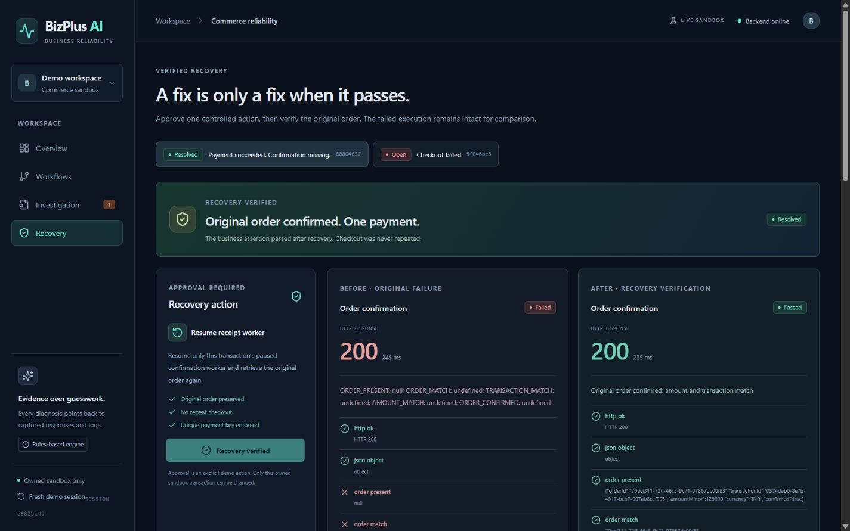
Failure investigation and verified recovery
1 Run Missing confirmation
2 Inspect response and logs
3 Approve worker resume
4 Verify the original order
1 payment before recovery 1 payment after recovery
BizPlus AI 5/7
Notes:
The screenshot shows an actual browser incident and recovery verification from a separate session. The failed confirmation has HTTP 200 with a missing order. Approval resumes that same transaction's worker. In the measured backend replay, verification preserved order 56200da6-f4c1-4088-a281-6cd9238c2d31. Payment count before: 1. Payment count after: 1. Never rerun checkout to recover this outcome. Repeated approvals are idempotent.

Slide 6
Measured sandbox results
Measured check | Observed result
Automated tests | 11 / 11 passed
Healthy journey | 1221 ms
Missing confirmation | 1180 ms
Recovery verification | 247 ms
Payments before and after | 1 and 1
Focused demonstration
Missing business outcome
Evidence linked to rules
Approval with verification
Timings include the sandbox’s 220 ms request delay.
Existing tools offer assertions and AI diagnosis.
Our demo connects evidence to approved recovery.
BizPlus AI 6/7
Notes:
Measured 13 October 2026 10:27 IST. Local production backend and real HTTP sandbox replay. These are sandbox measurements, not production benchmarks. Healthy 1221 ms, checkout 500 1005 ms, missing confirmation 1180 ms, recovery verification 247 ms. Automated tests 11/11. Existing systems: New Relic supports synthetic API response assertions, https://docs.newrelic.com/docs/synthetics/synthetic-monitoring/scripting-monitors/write-synthetic-api-tests/ . Checkly offers AI root cause analysis, https://www.checklyhq.com/docs/resolve/ai-root-cause-analysis/overview/ . No industry-first claim. Differentiation here is the focused demonstrable connection from missing business outcome to evidence, approval, and original-order verification.

Slide 7
Release and roadmap
MVP now | Next release
Fixed owned shop journey | Authenticated operators and action audit
Rules with captured evidence | Evaluate optional LLM summaries
One safe approved recovery | Additional owned recovery policies
Temporary hosted history | Durable managed data storage
Deployment handoff
Netlify frontend and Render backend configuration included
Local API and browser journey verified. Public deployment and cold-start checks remain pending.
BizPlus AI 7/7
Notes:
Current release status: Local API and browser journey verified. Public deployment and cold-start checks remain pending.. Public demo: Not yet deployed. Repository: https://github.com/Emadfar007/bizplus-ai. Do not describe local verification as public deployment. Priorities are production authentication and an action audit policy, durable shared storage, then evaluated optional LLM summaries and additional owned journeys. Keep a local tested fallback for free-host cold starts. Hosting references: https://render.com/docs/free and https://docs.netlify.com/build/frameworks/framework-setup-guides/vite/ .

